Slide 1
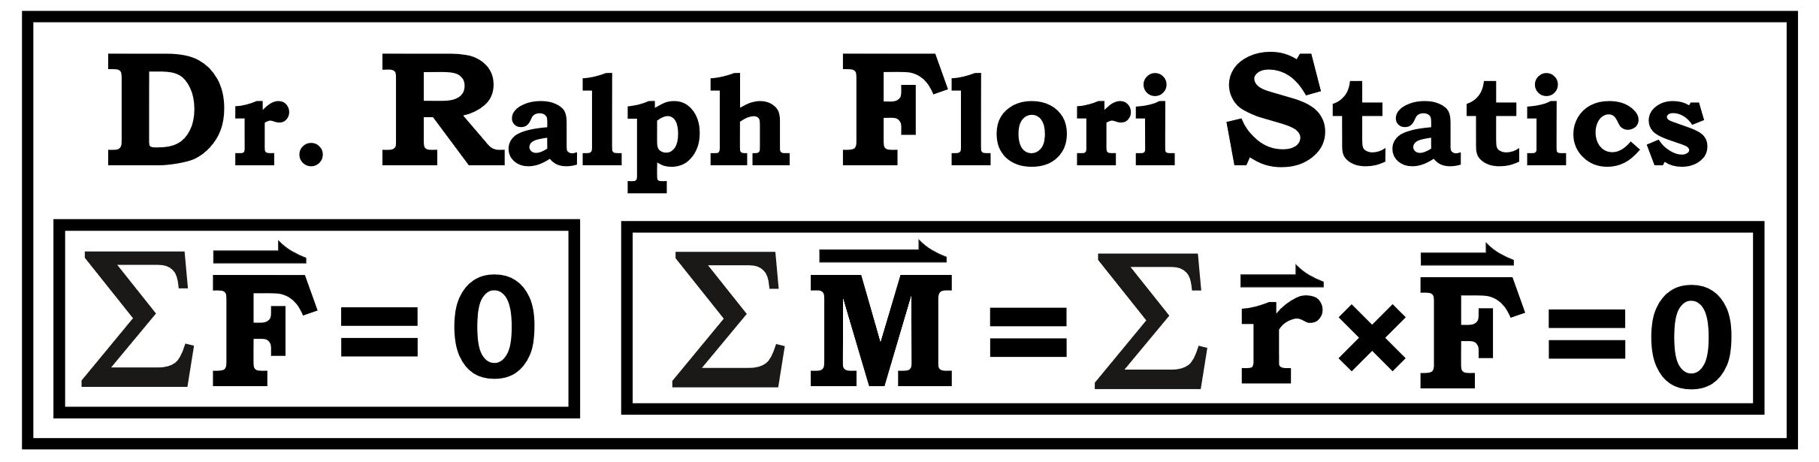
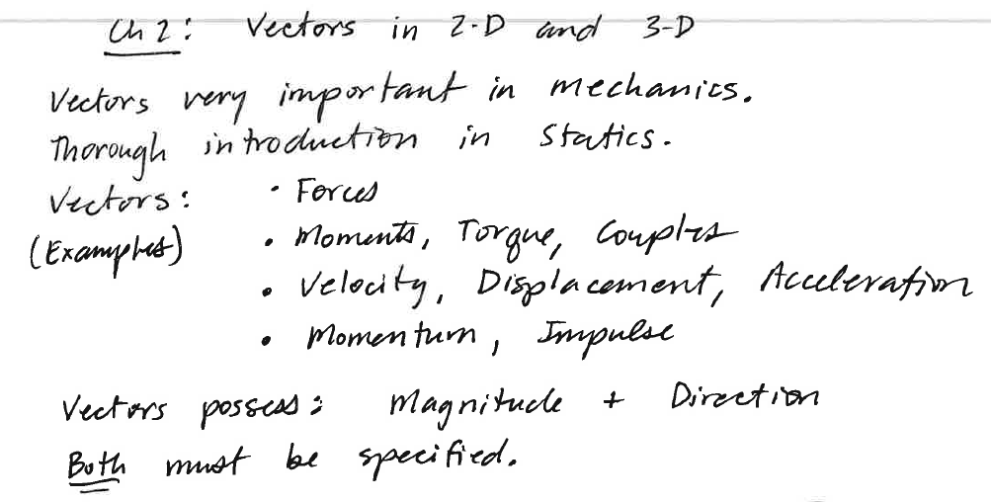
Representing Vectors in 2-D

Slide 2
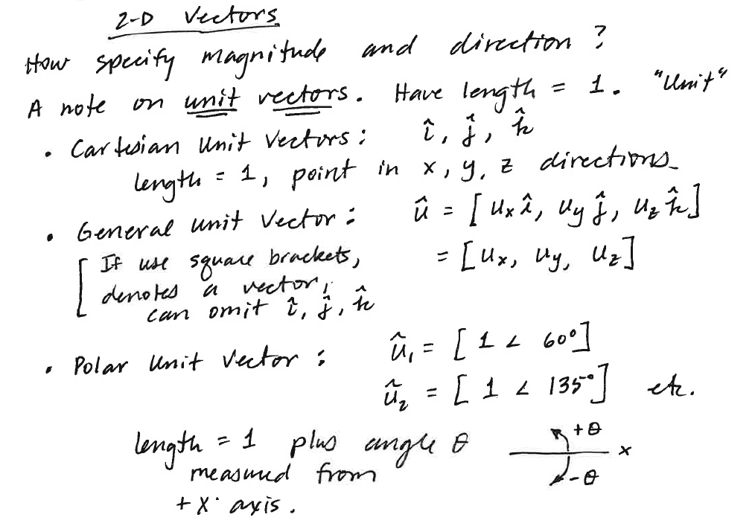
Representing Vectors in 2-D

Slide 3
Representing Vectors in 2-D

Slide 4
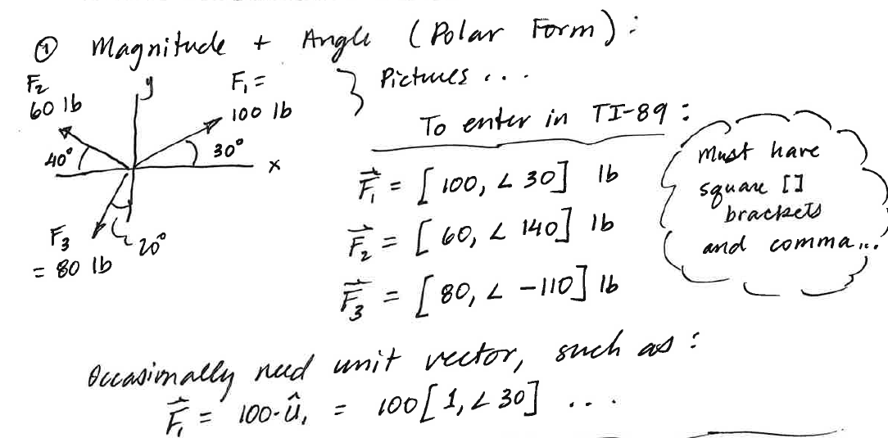
Representing Vectors in 2-D

Slide 5
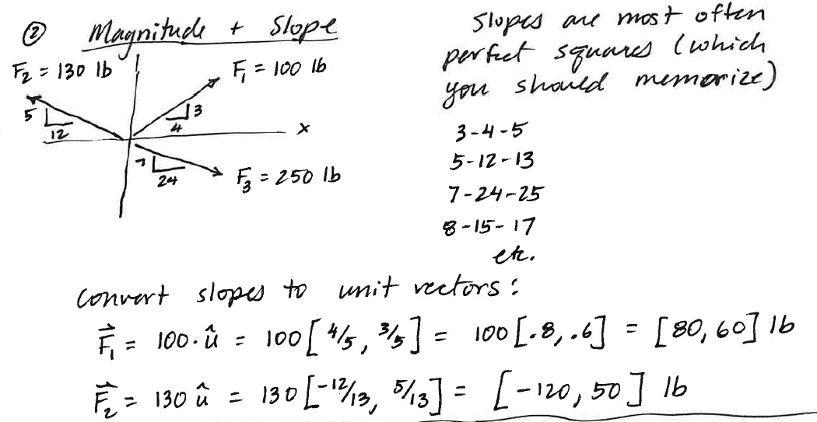
Representing Vectors in 2-D

Slide 6
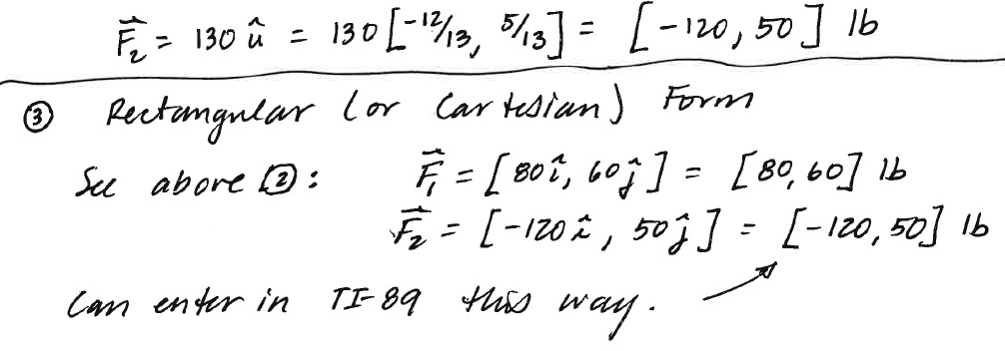
Representing Vectors in 2-D

